Slide 1
Lesson 1 Demonstrations
Condensation and Dew Point

Slide 2
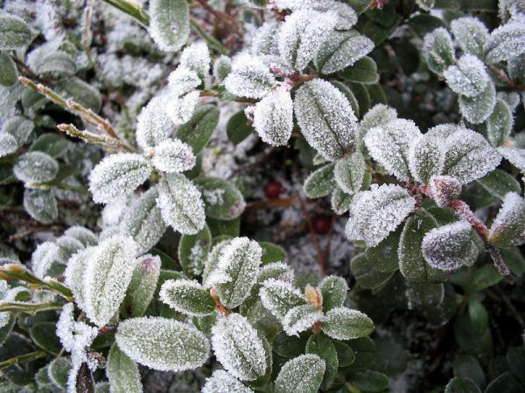
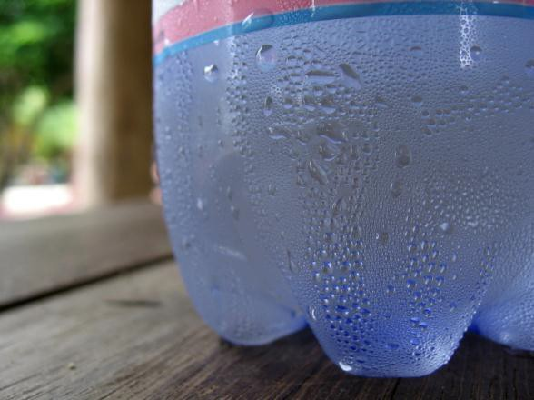
Condensation on the Outside
O If you live in a sufficiently humid climate (won’t work in the desert), keep a bottle of water in the refrigerator overnight.
O Pull it out and watch for condensation to occur on the
outside surface.
O Ask the students, where did that water come from? Was it from the inside? What will happen to this condensation as it warms up to room temperature and why?
You can also take a bottle out of the freezer and watch frost form on the outside surface.
Ask them why that occurred.

Slide 3
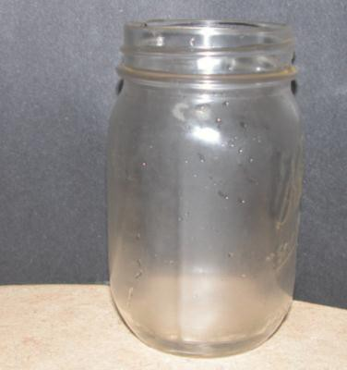
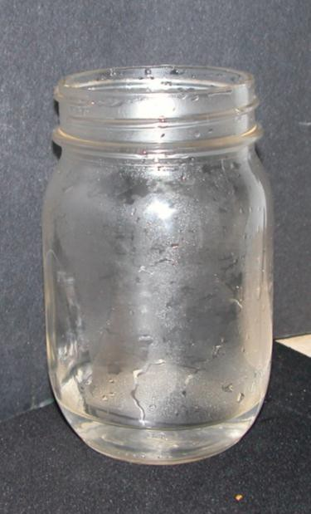
Condensation on the Inside
O Take an empty jar or bottle out of the refrigerator and let sit for 3 minutes.
O While waiting, heat a small quantity of water above 100°F.
O Pour little hot water into the jar.
O Condensation will form on the inside.
O Ask the students why this is occurred.
Hot water added to cool jar

Slide 4
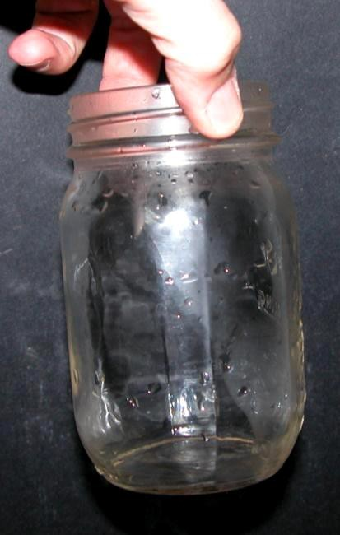
Evaporation on the Inside
O Place the bottle in the refrigerator for a few minutes and check back on it (this represents cooler air in the mountains).
O You will notice that the condensation is even more apparent. Ask the students why.
O Take it out of the refrigerator and pour hot water over the outside of the jar. You will see the condensation on the inside will evaporate where it was heated by the water.
O Explain that this is the equivalent to the Rainshadow effect and the clouds evaporating, due to adiabatic heating.
Line where warm water pouring on outside evaporated condensation on inside

Slide 5

This project was made possible in part by a grant from
Washington’s National Park Fund.

